Slide 1

Data Structures
Introduction to C++
Subin Sahayam, Assistant Professor,
Department of Computer Science and Engineering
Shiv Nadar University

Slide 2
Class Timings – AI & DS A
Theory:
Monday – 8.10 am to 9.00 am
Thursday – 10.10 am to 11.00 am
Friday – 12.50 pm to 01.40 pm
Lab:
Friday – 08.50 am to 9.00 am (Tutorial)
Wednesday – 9.00 am to 11.50 am

Slide 3
Class Timings – AI & DS B
Theory:
Monday – 12.50 pm to 01.40 pm
Tuesday – 2.40 pm to 03.30 pm
Thursday – 8.10 am to 9.00 am
Lab:
Monday – 09.00 am to 11.50 am
Friday – 02.40 pm to 03.30 pm (Tutorial)

Slide 4
Marks Split-up
Theory
Mid Semester - 30 marks
End Semester - 50 marks
CIA/Assignment - 20 marks
Lab
Lab and Model Exam - 20 marks
End Semester Exams – 80 marks

Slide 5
Prerequisites
Programming
Discrete Mathematics
Data Structures

Slide 6
Bloom's Taxonomy?

Slide 7
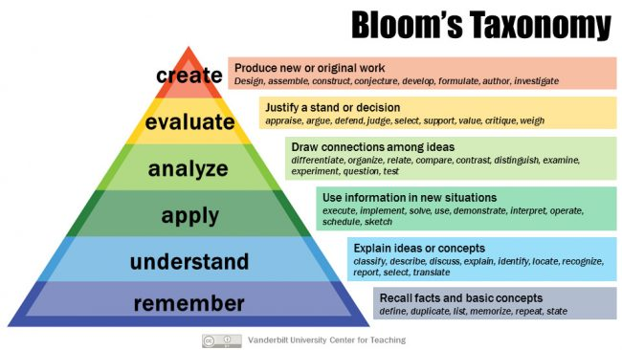
Bloom's Taxonomy

Slide 8
Course Outcomes
CO1 – Apply abstraction and the basics of complexity analysis – K3
CO2 – Apply various linear data structures to store, organize and retrieve data – K3
CO3 – Apply various non- linear data structures to store, organize and retrieve data – K3
CO4 - Analyze the time and space complexity of various data structures – K4
CO5 – Evaluate across various data structures for a given context – K5
K1

Slide 9
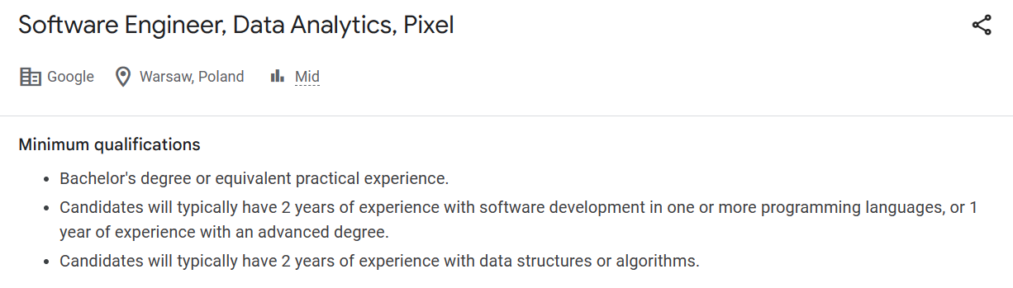
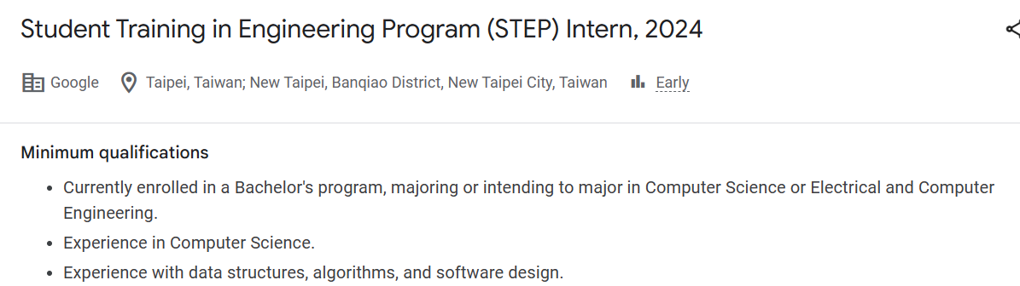
Careers
K2

Slide 10
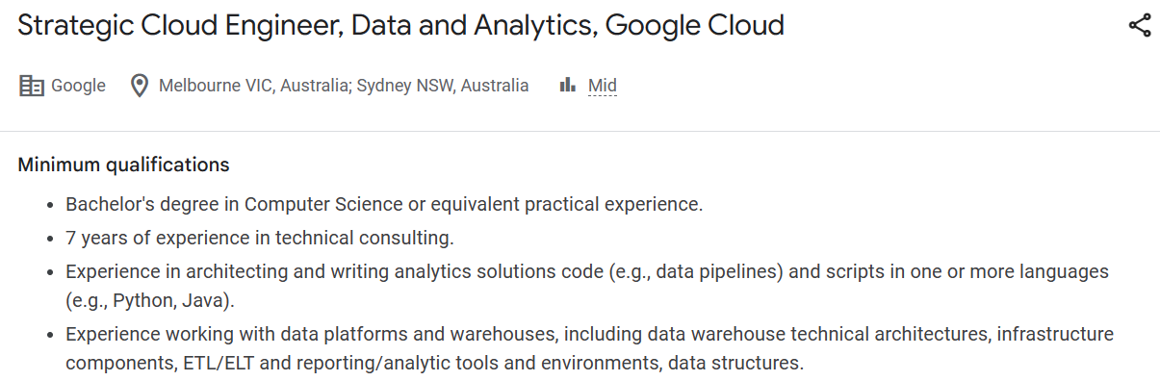
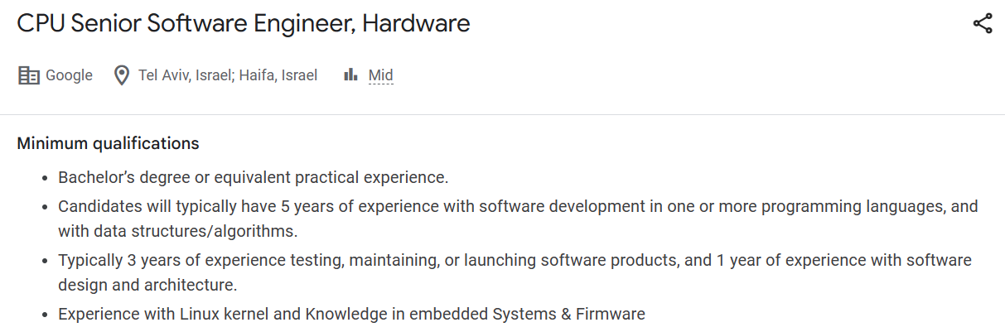
Careers
K2

Slide 11
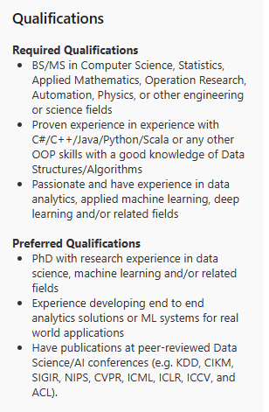
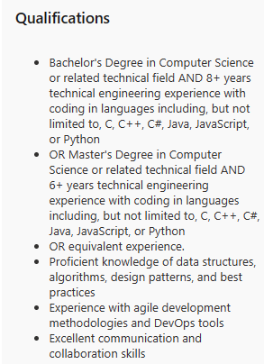
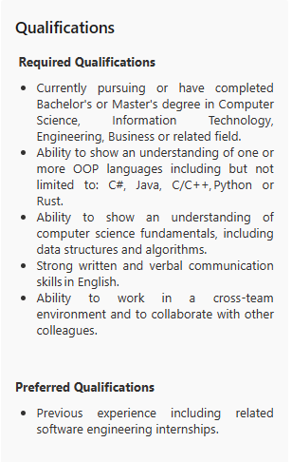
Careers
Senior Data Scientist
Senior Software Engineer- Azure Data Engineering
Software Engineering Intern
K2

Slide 12
Software Development Life-Cycle?

Slide 13
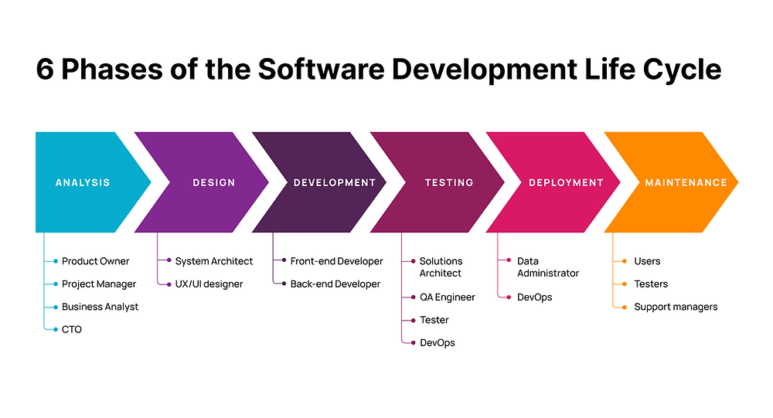
Software Development Life-Cycle
K2

Slide 14
Questions?

Slide 15
Review of C
K2

Slide 16
Review of C
C => Programming Language
K2

Slide 17
Review of C
C => Programming Language
Program?
Language?
K2

Slide 18
Review of C
C => Programming Language
Program?
A meaningful set of syntactically correct statements/instructions that solves a computational problem.
Language?
K2

Slide 19
Review of C
C => Programming Language
Program?
A meaningful set of syntactically correct statements/instructions that solves a computational problem.
Language?
A grammatical set of meaningful sentences used for communication.
K2

Slide 20
Language
C => Programming Language
K2

Slide 21
Language
 | English | C
Alphabet | A-Z, a-z | A-Z, a-z
Numbers | 0-9 | 0-9, 0 and 1, 0-7, 0-F
Words | Words | Tokens
Sentences | Grammar + Words = Sentences | Syntax + Tokens = Statements
Paragraph | Paragraph | Block
Chapter/Book | Chapter/Book | Program
Library | Library | Library
K2

Slide 22
Questions?

Slide 23
Datatypes in C
K1

Slide 24
Datatypes in C
Basic Datatypes
Derived Datatypes
K1

Slide 25
Datatypes in C
Basic Datatypes
int
float
char
void
double
Derived Datatypes
K1

Slide 26
Datatypes in C
Basic Datatypes
Derived Datatypes
Arrays
Functions
Pointers
Unions
Structures
K1

Slide 27
Datatypes in C
What is used to create new datatypes?
K1

Slide 28
Datatypes in C
What is used to create new datatypes?
Structure
Union
K1

Slide 29
Datatypes in C
What is used to create new datatypes?
Structure
Union
Drawback of Structure?
K1

Slide 30
Datatypes in C
What is used to create new datatypes?
Structure
Union
Drawback of Structure?
Not treated as built-in
Operations not possible on struct objects (Eg: addition of one structures or more)
Functions are not possible directly
Need to separately initialize data members on object creation
Lack of data protection
K2

Slide 31
Introduction to C++
Improvement over C - Bjarne Stroustrup
K1

Slide 32
Introduction to C++
Improvement over C - Bjarne Stroustrup
Features
Classes and Objects
Encapsulation
Data Hiding
Data Abstraction
Constructors and Destructors
Polymorphism
Inheritance
K1

Slide 33
Introduction to C++
Classes <=> Struct
Objects - same as in C
Encapsulation
Binding Data Member + Member Functions
K1

Slide 34
Introduction to C++
Syntax
class classname
{
access_specifier:
data_type data_member_identifier;
return_type member_functions/methods(<arguments>);
};
K1

Slide 35
Today's Course Outcomes
CO1 – Apply abstraction and the basics of complexity analysis – K3
CO2 – Apply various linear data structures to store and retrieve data – K3
CO3 – Apply various non- linear data structures to store and retrieve data – K3
CO4 - Analyze the time and space complexity of various data structures – K4
CO5 – Evaluate across various data structures for a given context – K5
K1

Slide 36
Summary
Class Timings
Mark Split-Up
Pre-requisites
Bloom's Taxonomy
Course Outcomes
Careers
Software Development Life-Cycle
Review of C
Language
Datatypes in C
Introduction to C++
Today's Course Outcome

Slide 37
References
Allen, Weiss Mark. Data structures and algorithm analysis in C++. 4th Edition, Pearson Education India, 2016.
Cormen, Thomas H., et al. Introduction to algorithms. MIT press, 2009.

Slide 38
THANK YOU

